Slide 1


A SEMINAR
INDUCTION TYPE ENERGY METER
By : BURHAN NISAR
Student SSM COLLEGE
Enroll : 5520

Slide 2
Contents
Introduction
Electromagnetic induction
Energy meter
Construction of induction type energy meter
Working
Advantages and disadvantages

Slide 3
INTRODUCTION
An instrument that is used to measure either the quantity of electricity or energy over a period of time is known as energy meter or watt hour meter
For measurement of energy in AC circuit, the meter used is based on electromagnetic induction principle. They are known as induction type instruments
Basically the induction energy meter may be derived from induction watt meter by substituting for spring control pointer, an eddy current brake and counting train respectively.

Slide 4
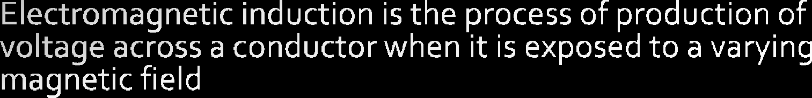
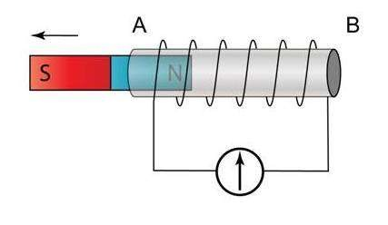

Slide 5

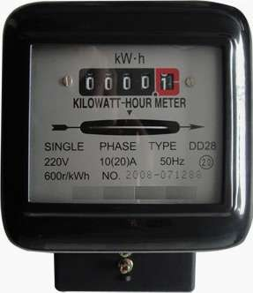





Slide 6
Construction:
Driving System
Moving System
Breaking System
Registering system

Slide 7













Voltage coil is connected to supply means and has many turns, and produces high ratio of inductance to resistance

Slide 8

When the energy meter is connected in the circuit, the current coil carries the load current and the pressure coil carries the current proportional to the supply voltage.
The magnetic field produced by the SERIES magnet (series coil) is in phase with the line current & the magnetic field produced by the shunt magnet (pressure coil) is in quadrature with the applied voltage (since the coil is highly inductive).
Thus, a phase difference exists between the fluxes produced by the two coils. This sets up a rotating field which interacts with the eddy current produced in the disc(because of induced emf) and produces a driving torque and, thus, disc starts rotating.
The number of revolutions made by the disc depends upon the energy passing through the meter. The spindle is geared to the recording mechanism so that electrical energy consumed in the circuit is directly registered in KWh.

Slide 9


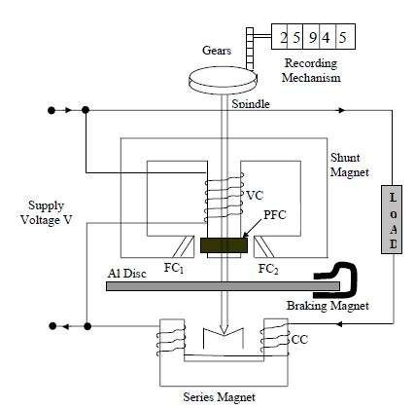
Continue….

Slide 10




Slide 11
DISADVANTAGES
Used only for AC measurement
Consume a considerable amount of power

Slide 12
Thank you

